Slide 1
《英语国家社会与文化入门》(上册）
The Society and Culture
of Major English-Speaking Countries
An Introduction
(Book One)

Slide 2
Australia Unit 15 The Land of the Peoples of the Dreaming

Slide 3
Quiz
Give the English and a brief explanation for the following:
梦创时代
大分水岭
大堡礁
无人拥有的土地
土著人

Slide 4
Focal Points
the natural environment of Australia
distinctive features of the land
distinctive animals of the land
the indigenous peoples
Dreaming and Dreamtime
the concept of Terra Nullius
impact of colonization on the indigenous peoples
policies of segregation and assimilation

Slide 5
This Unit Is Divided into Two Sections
The
The Peoples

Slide 6
I. The Land
The continent of Australia lies between equatorial South East Asia and the Antarctic.
The coastline of 30 000 of Australia is kilometres and its land area is 7 682 300 km², almost equals that of the United States.
The country also includes Tasmania, an island just to the south, the Torres Straits Islands off the northern coast of the mainland and a small number of islands in the Pacific and the Indian Oceans.

Slide 7
I. The Land
The continent of Australia lies between equatorial South East Asia and the Antarctic.

Slide 8
I. The Land

Slide 9
I. The Land
Isolated from other major land masses, Australia’s distinctive flora and fauna evolved through its long period as an island continent. One of the animals that are unique to the continent is the platypus – often described as the world’s most unusual animal.

Slide 10
I. The Land
The kangaroo – a macropod (meaning ‘large footed’) is sometimes as much as two metres in height. It is a marsupial which means that the young ‘joeys’, or baby kangaroos, live in the mother’s pouch until they are ready to fend for themselves

Slide 11
I. The Land
The koala is another marsupial but one looks like a small, woolly, grey and white bear. It lives mainly in the branches of trees, especially the eucalyptus whose leaves are the koala’s main food.

Slide 12
I. The Land
The wombat is a squat, round, bear-like, burrowing marsupial, about one metre in length, with short legs, small ears and eyes and a thick, coarse fur of brown or grey.

Slide 13
I. The Land
The landscape of the country is extremely variable. In the north are tropical rainforests.
Snowfields occupy the plateau landscapes of the southeast.
In the Mediterranean and temperate climates of the hills and fertile plains bordering the east, south and the south west of the continent that eighty per cent of Australians live today.

Slide 14
I. The Land
The map shows the topography of Australia

Slide 15
I. The Land
One of the country’s most distinctive physical features is the Great Dividing Range. It extends as an almost unbroken series of plateaus down the East Coast of Australia, from northern Queensland, through New South Wales and into Victoria.

Slide 16
I. The Land
The Great Barrier Reef, off shore, is the largest coral structure in the world, extending for over 2 000 kilometres along the coast of Queensland.

Slide 17
II. The Peoples
This section is sub-divided into five parts:
“Dreamtime” or “Dreaming”
Contact of the Concept of Terra Nullius
The Impact of Colonisation
The Policies of Segregation and Exclusion
The Policy of Assimilation

Slide 18
II. The Peoples
“Dreamtime” or “Dreaming”
Much debate exists among researchers about when the ancestors of Aboriginal Australians arrived on the continent. While most agree that Aboriginal people first migrated from Africa via Asia approximately 50,000 years ago. These indigenous peoples are called the peoples of the Dreaming.
The people of the Dreaming belonged to about 600 different groups or nations with different languages and cultures.
But they were bound together by their belief in the ‘The Dreaming’ or ‘The Dreamtime’.

Slide 19
II. The Peoples
‘The Dreaming’ or ‘The Dreamtime’ is the most enduring religion in Australia today. It is based on the central principle that the people who live on the continent have special responsibilities to the land—that the land owns them and that they hold it in trust as the home of their creator.
The Dreaming, or “Tjukurrpa”, also means to “see and understand the law”. Dreaming stories pass on important knowledge, cultural values and belief systems to later generations.

Slide 20
II. The Peoples
Through song, dance, painting and storytelling which express the dreaming stories, Aborigines have maintained a link with the Dreaming from ancient times to today, creating a rich cultural heritage.

Slide 21
II. The Peoples
The Peoples of the Dreaming have sacred creation stories which not only explain about how the country came to be formed, but also provide principles of how people should live and interact with others. The people of the Dreaming lived in a complex spiritual and social world. The stories of creation also provide a memorable map of the landscape. For people outside of this culture the desert seems to be empty and life threatening. However, the intricate and specific detail of the stories of the Dreaming transform the desert into a familiar and life sustaining landscape: the Peoples of the Dreamtime know how to find water, even in the desert areas, because the special stories within the Dreaming provide a detailed knowledge of their.

Slide 22
II. The Peoples
After 1788 colonists and developers took over the country. They exploited the intricate understanding intellectual skills of the peoples of the Dreaming in developing sealing industry, raising cattle and sheep.
The labour and skills of the indigenous people were used by the colonists, but they were paid no wages and treated as though they were part of the fauna of the country rather than as people with human rights.
The First Fleet entering Port Jackson on 26 January 1788 by E. Le Bihan

Slide 23
II. The Peoples
B. Contact and the Concept of Terra Nullius
In 1405, Zhu Di the Ming emperor commissioned Zheng He to take 317 of his ships to the Middle East and Eastern Africa. There is evidence that several ships from that armada landed on the Aru Islands to the north of Arnhem Land (part of Australia).
There are records in the art of the Peoples of the Dreaming of the arrival of various European travellers, Portuguese, Spanish and Dutch explorers.
However, it was the British who took over the country in the late eighteenth century, declaring it to be ‘terra nullius’ – an unkownd wasteland which could, legitimately, be colonised. terra nullius. By declaring Australia ‘ terra nullius ’ the British were not only claiming that they could take possession of the land but that they could dismiss those who had lived there for 18 000 or so generations as a people who were not fully human and who were certainly not “civilised”.

Slide 24
II. The Peoples
These one million or so people who lived on the land were grouped together under the one name: “the Aborigines, meaning the original natives of the land.

Slide 25
II. The Peoples
C. The Impact of Colonisation
Approximately 20 000 Aborigines were killed in violent skirmishes and
massacres in the first decades of colonisation.
In some areas martial law was declared against those Aborigines who attempted to prevent the settlers from taking over their hunting and collecting grounds. In Tasmania where the indigenous people were hunted down systematically.
Even more disastrous to the Peoples of the Dreaming were the diseases that the colonists brought with them. So many were killed by the imported diseases that the People were soon no longer seen as a threat to settlement.

Slide 26
II. The People
Massacre of the aborigines of Australia by white settlers and the
resistance by the aboriginal people.

Slide 27
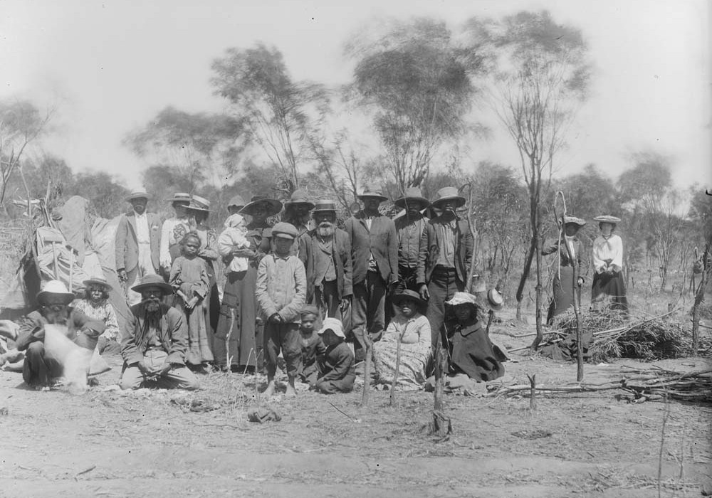
II. The Peoples
D. The Policies of Segregation and Exclusion
By the mid 1800s the government practices of violence changed to policies of segregation and exclusion. The aboriginal people were forcibly taken from their own land and put on reserves where they were placed under the absolute control of white officials.

Slide 28
II. The Peoples
Social scientists of the nineteenth century adapted the general Darwinian theory of evolution to develop a theory of a hierarchy of races, with the white colonising peoples located at the top and the black nomadic peoples, whom they colonised and exploited, at the bottom of the scale. In Australia these racist theories legitimated even further forms of exploitation and appropriation of land as the white settlers took over more of the country. Meanwhile, on the reserves, the Peoples of the Dreaming were denied basic rights.

Slide 29
II. The Peoples
E. The Policy of Assimilation
By the beginning of the twentieth century the policy of
protected reserves had been replaced by the policy of assimilation.
- “Assimilation” was founded on the belief that the white culture was the progressive and superior whereas the Dreamtime was only a form of superstition

Slide 30
II. The Peoples
Children were taken away from their parents to be placed in church-run institutions and the missionaries on the ‘protected reserves’ set out to destroy the culture of the Dreaming and to replace it with Christianity. As the children grew to adulthood many of them had lost both their families and their culture.

Slide 31
II. The Peoples
They were employed as domestic servants or on cattle stations but were paid only with food and clothes or with wages that were only a fraction of those paid to white workers.

Slide 32
II. The Peoples
Young Aboriginal women were continually at risk of rape on the reserves, institutions, and in their places of employment.

Slide 33
II. The Peoples
“Assimilation” was accompanied by segregation. Aboriginal people were excluded from the social, the political and the working life of mainstream Australians. They had unequal conditions of entry into public houses, swimming pools and cinemas and were excluded from mainstream education and health services. They were also excluded from many forms of employment and from citizenship: Aboriginal people could not vote. Racism was an entrenched part of Australian culture until the 1960s.

Slide 34
II. The Peoples
Conclusion
The history of contact has been a history of loss for the Peoples of the Dreaming, a history of:
stolen land
stolen wages
stolen culture
stolen children

Slide 35
Questions for Discussion
A. What are the unique features of the Australian continent?
B. Discuss the social and cultural values embodied in the Dreaming.
C. What do you know about Zheng He’s voyages in the 15th century? Do you think his fleet got to the northern part of Australia? Why?
E. What is the impact of the assimilation policy on the indigenous people?

Slide 36
The End
高等教育出版社
2015

